Slide 1
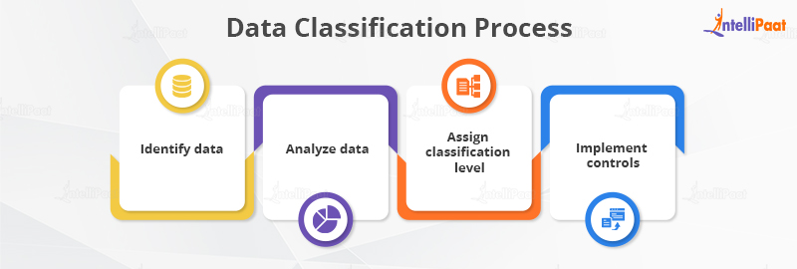
What is Data classification ???
Data classification is the process of categorizing data based on its sensitivity, importance, or other criteria. It involves labeling data with tags or metadata to indicate its level of confidentiality, integrity, and availability, thereby facilitating appropriate handling, storage, and protection measures.

Slide 2
Example ;
An example of data classification is in an organization where data is categorized into public, internal, confidential, and restricted categories. Public data might include marketing materials or press releases, while internal data could consist of employee handbooks or internal memos. Confidential data could be financial reports or customer information, and restricted data might include trade secrets or sensitive personal data subject to legal protection. Each category would have different access controls, encryption requirements, and handling procedures based on its classification level.

Slide 3
Types of data classification
There are several types of data classification, including:
Hierarchical Classification: Data is classified into a hierarchical structure, typically ranging from less sensitive to highly sensitive categories.
Binary Classification: Data is classified into just two categories, such as public and confidential.
Multi-level Classification: Data is classified into multiple levels or tiers based on sensitivity, such as low, medium, and high.
Content-based Classification: Data is classified based on its content, such as keywords, patterns, or characteristics.
Contextual Classification: Data is classified based on its context, including its intended use, location, or user accessing it.
Statistical Classification: Data is classified using statistical analysis techniques, such as clustering or decision trees.
Automated Classification: Data is classified automatically using algorithms or machine learning models, without manual intervention.
These types of classification can be used individually or in combination, depending on the specific needs and requirements of an organization.

Slide 4
Advantages;
Advantages of data classification in simple terms:
Better Security: Keeps important stuff safe from bad guys.
Following Rules: Helps organizations follow the law and industry rules about data.
Less Risk: Helps find and fix problems before they become big issues.
Easy Organization: Makes it easier to find and handle data.
Saving Money: Helps use money wisely by spending it where it's needed most.
Smarter Decisions: Helps make better choices by knowing which data is most important.
Teamwork: Makes it easier for everyone to work together by making data easier to share.

Slide 5
Disadvantages;
Some of disadvantages are:
Too Simple: Sometimes, it makes things too basic and loses important details.
Opinion-based: People might classify things differently, leading to confusion.
Hard to Change: Once classified, it's tough to update or change things.
Loses Details: Classifying data can hide important information.
Misunderstandings: People might not understand the classifications, leading to mistakes.
Not Flexible: It might not adapt well to new information or changes.
Complicated: Setting up classifications can be tricky and needs expertise.
Costly: It can be expensive in terms of time and resources.

Slide 6
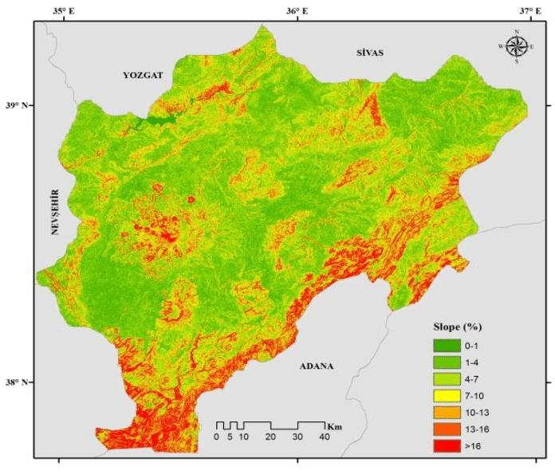
What is Re-classification Measurements???
Reclassification measurement in GIS means checking how changing categories or groups of data affects the accuracy and usefulness of maps and information. It's like making sure that when you rearrange how things are labeled on a map, it still makes sense and gives the right information.
Reclassification measurement in GIS means checking how changing categories or groups of data affects the accuracy and usefulness of maps and information. It's like making sure that when you rearrange how things are labeled on a map, it still makes sense and gives the right information.

Slide 7
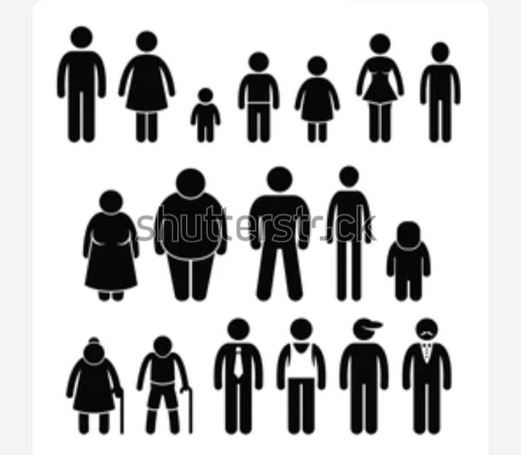
Example;
Example of Re-classification measurement;
Let’s suppose we have a group of 50 students,
and we want to measure their heights.
then we can classify them into different height categories,
Such as "short," "average," and "tall.“
This is a form of reclassification measurement!

Slide 8



